Slide 1
Case Study 1 – Increase Products Per Customer ( PPC )
Case Study – 1 | PPC
Case – 1 PPC
Your client ABC is a leading bank in India and offers various products – assets (home loan, auto loan, mortgage, credit card etc), liabilities, wealth management. It is looking to increase product penetration amongst it’s customer base. The current PPC, on an average, is 1 and the bank wants to increase this to 5 over the next 2 years. You need to arrive at a strategy that will help the bank achieve this objective.
Group Members(BDAP 2016 Part Time Batch) –
Sachidanand Tripathi
Tej Trivedi
Dattatray Shinde
Kaushik Suryanarayanan

Slide 2
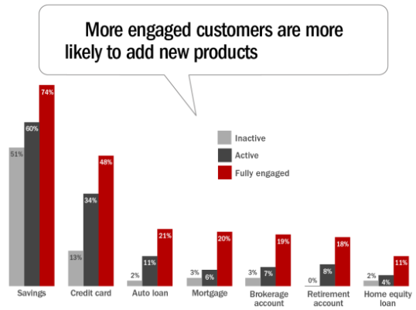
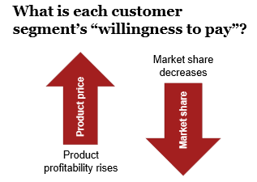
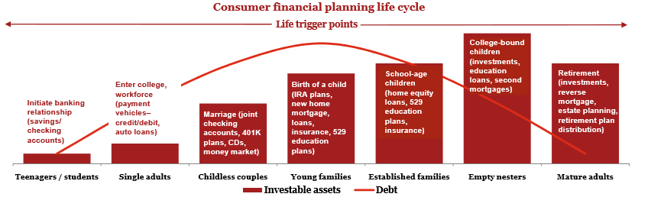
Industry Research – Key trends / drivers
Industry Research – Key trends / drivers
Key Trends:
92% of households have a checking or savings account with at least one Bank.
It costs banks 8-10 times more to gain a new customer than it does to sell a new product to an existing customer.
A customer who has a single product with a bank stays for about a year and a half, but the average customer with three products will stay for nearly seven years.
Average customer has 6.1 bank products, only half of them are with customer’s primary bank.
Survey Results:
64% of respondents have brokerage accounts held at a non-primary Bank
85% of insurance holders purchased it from a non-primary Bank
89% of respondents either do not use financial planning services or obtain them from a non-primary Bank
% of customers saying they will “not switch banks” fell from 46% in 2014 to 34 % in 2015

Slide 3
Problem Statement Worksheet
Increase products per customer
How can ABC bank increase it’s average of Product Per Customer from 1 to 5 in the next 2 years?
1. Background
4. Constraints
Due to increased competition, in last few years, the current average product per customer for ABC Bank in India .
The Bank is looking at guidance to arrive at a strategy to increase the average product per customer
Inorganic growth
Involuntary withdrawal of existing products due to unavoidable reasons
Regulatory changes in banking
2. Desired outcome
5. Stakeholder
Increase in average product per customer, from 1 to 5, in the next 2 years
Improved profitable long term customer relationship with bank
Increased total revenues, wallet share and product penetration
Sales & Marketing Team of ABC Bank
Products Subject Matter Experts.
3. Scope
6. Resource
In scope -
Indian Market
Analyzing overall customer portfolio
Retain engagement of satisfied customers
Out of scope -
Cannibalization effect on existing bank products
Data available with Bank
Information gathered through research
Targeted Interview with stakeholders

Slide 4
Issue Tree
Increase products per customer
Issue Tree
A
Increase PPC by organic growth
Cross- Sell to existing customers
Increase products per customer
B
Sell to new customers
How can ABC bank increase its average PPC, from 1 to 5 in the next 2 years?
Increase PPC by inorganic growth
Reduce involuntary cancellation
Reduce cancellation of products used by existing customers
C
Reduce voluntary cancellation
In Scope
Out of Scope / Constraint

Slide 5
Issue Tree
Increase products per customer
Issue Tree
A1
Classify Customer as Teenagers
Satisfied customers
A2
Classify Customer as Single Adults
Issue Tree
A
A3
Cross- Sell to existing customers
Classify Customer as Childless Couples
A4
A6
Classify Customer as Young Families
Dissatisfied customers
A5
Classify Customer as Mature Adults
In Scope

Slide 6
Issue Tree
Increase products per customer
Issue Tree
Issue Tree
Banks Offers Debit Card
Bank Recommend Products for Teenager
Banks offers education loan
A1
Classify Customers as Teenagers
Banks offers other products
Teenager opts for additional product
In Scope
Terminal Node

Slide 7
Issue Tree
Increase products per customer
Issue Tree
Banks Offers Debit Card
Bank Offers Credit Card
Bank Recommend Products for Single Adults
Banks offers Education Loan
A2
Bank offers Auto Loan
Classify Customer as Single Adults
Bank offers Home Loan
Single Adults
opt for additional product
Bank offers DEMAT Account
Bank Offers RD /FD
In Scope
Bank offers other products
Terminal Node

Slide 8
Issue Tree
Increase products per customer
Issue Tree
Banks Offers Debit Card
Bank Offers Credit Card
Bank Recommend Products for Childless Couples
Bank offers Joint Account
A3
Bank offers Auto Loan
Classify Customer as Childless Couples
Bank offers Home Loan
Childless Couples
opt for additional product
Childless Couples
opts for additional product
Bank offers DEMAT Account
Bank Offers RD /FD
In Scope
Bank offers other products
Terminal Node

Slide 9
Issue Tree
Increase products per customer
Issue Tree
Bank offers Education Plans
Bank offers Insurance Plans
Banks Offers Debit Card
Bank Recommend Products for Young Families
Bank Offers Credit Card
A4
Classify Customers as Young Families
Bank Offers RD /FD
Young Families
opt for additional product
Bank offers Auto Loan
Bank offers Home Loan
Bank offers Joint Account
In Scope
Bank offers Other Products
Terminal Node

Slide 10
Issue Tree
Increase products per customer
Issue Tree
Bank offers Retirement Plan
Bank offers Insurance Plans
Banks Offers Debit Card
Bank Recommend Products for Mature Adults
A5
Bank Offers Credit Card
Classify Customers as Mature Adults
Bank Offers RD /FD
Mature Adults opt for additional product
Bank offers Auto Loan
Bank offers Personal Loan
In Scope
Bank offers Other Products
Terminal Node

Slide 11
Issue Tree
Increase products per customer
Issue Tree
Bank offers upsell products
Dissatisfied with service
A6
Bank offers value added services
Dissatisfied customers
Dissatisfied with products
Bank offers other product/services
In Scope
Terminal Node

Slide 12
Issue Tree
Increase products per customer
Issue Tree
Classify Customers as Teenagers
Classify Customers as Single Adults
B
Sell to new customers
Classify Customers as Childless Couples
Bank Offers Bundled Products
Classify Customers as Young Families
Bank Offers Bundled Products
Out Of Scope
Classify Customers as Mature Adults
Bank Offers Bundled Products
In Scope
Terminal Node

Slide 13
Issue Tree
Increase products per customer
Issue Tree
Satisfied customers
Bank offers upsell products
C
Reduce voluntary cancellation
Dissatisfied with service
Dissatisfied customers
Bank offers value added services
Dissatisfied with products
Bank offers other product/services
Out Of Scope
In Scope
Terminal Node

Slide 14

Issue Tree

